Slide 1
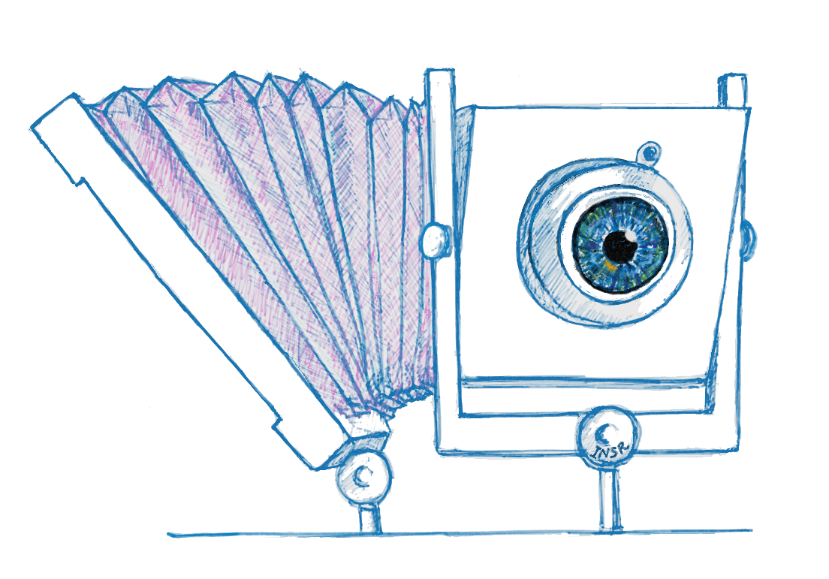
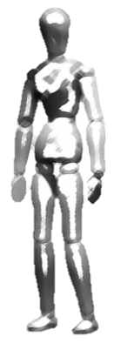
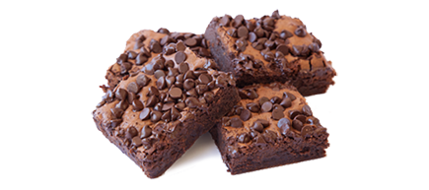
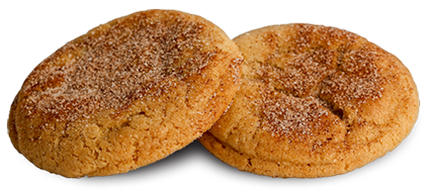
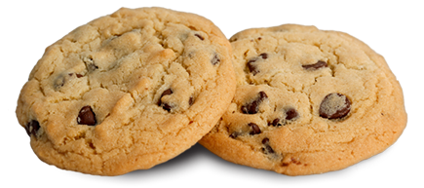
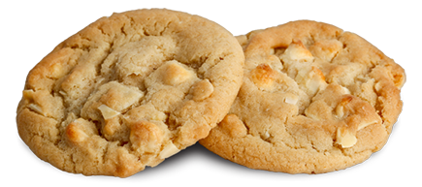
Scheimpflug with Computational Imaging to Extend
the Depth of Field of Iris Recognition Systems
Indranil Sinharoy
Dr. Marc P. Christensen
Dr. Delores M. Etter
Dr. Dinesh Rajan
Dr. Panos Papamichalis
Dr. Yunkai Zhou
Committee:
Please help yourself with some cookies, brownies and soft drinks.
Thank you.

Slide 2
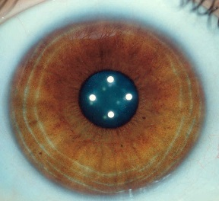
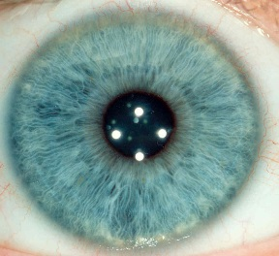
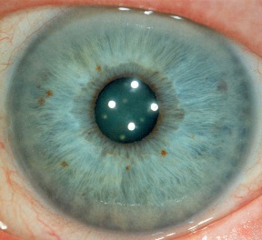
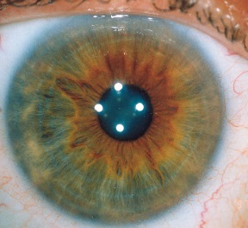
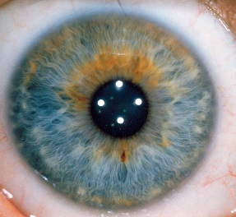
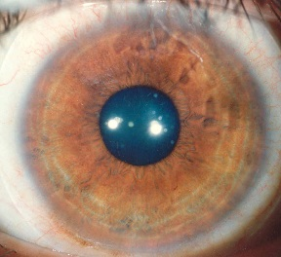
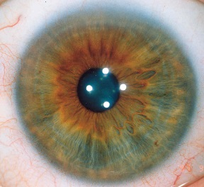
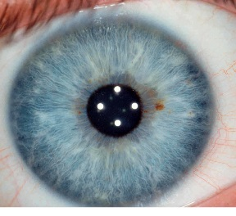
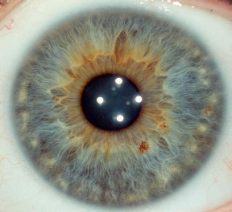
Unique
0.000000000000000000000000000000000000000000000000000000000000000000000001
[Photographs by Jon Miles, milesresearch.com]
Notes:
That’s 71 zeros between the decimal point and the one. That’s the probability that two irises, the colored tissue surrounding the pupils in the eyes, picked at random, will exactly match. That is how staggeringly unique each iris pattern is … but that’s not all.

Slide 3
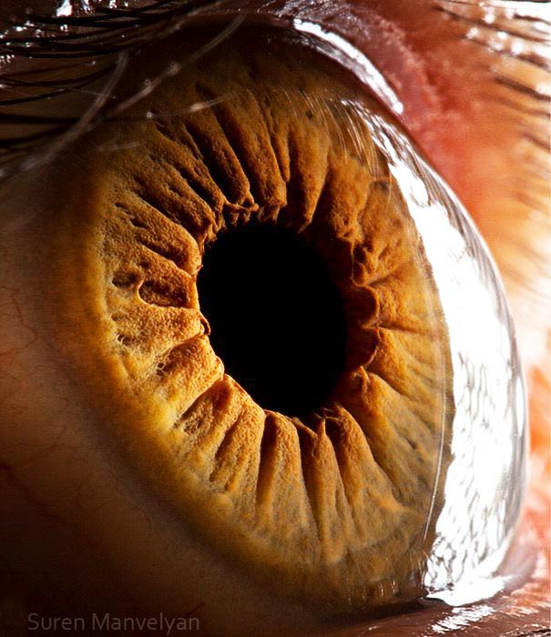
Several desirable properties of the iris pattern make it an ideal biometric
Uniuqe
Stable over time
Protected by the cornea from tampering
Easily accessible
[Photograph by Suren Manvelyan, surenmanvelyan.com]
Notes:
Since the transparent cornea covers the iris … it is relatively safe from both accidental and intentional tampering.

Slide 4
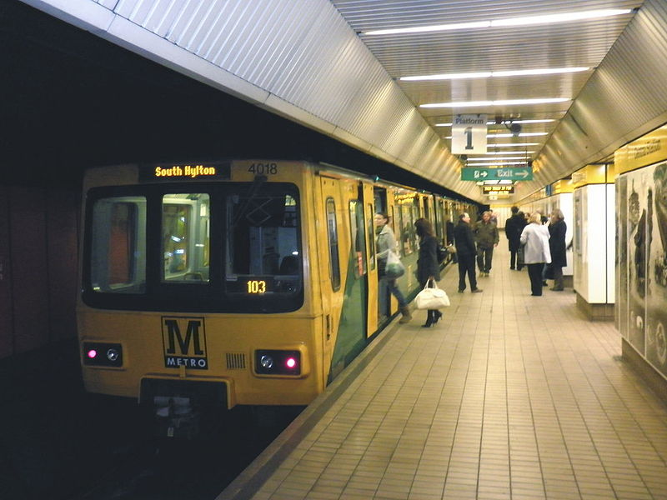
Iris recognition technology has great potential for providing robust surveillance
[Roger Cornfoot [CC BY-SA 2.0 (http://creativecommons.org/licenses/by-sa/2.0)], via Wikimedia Commons]
Notes:
In recent years, public safety concerns have increased significantly. There is a huge demand for robust surveillance in large, uncontrolled environments to provide public safety.
And iris recognition technology has the potential for providing such robust and automated surveillance.
But there is a problem!

Slide 5
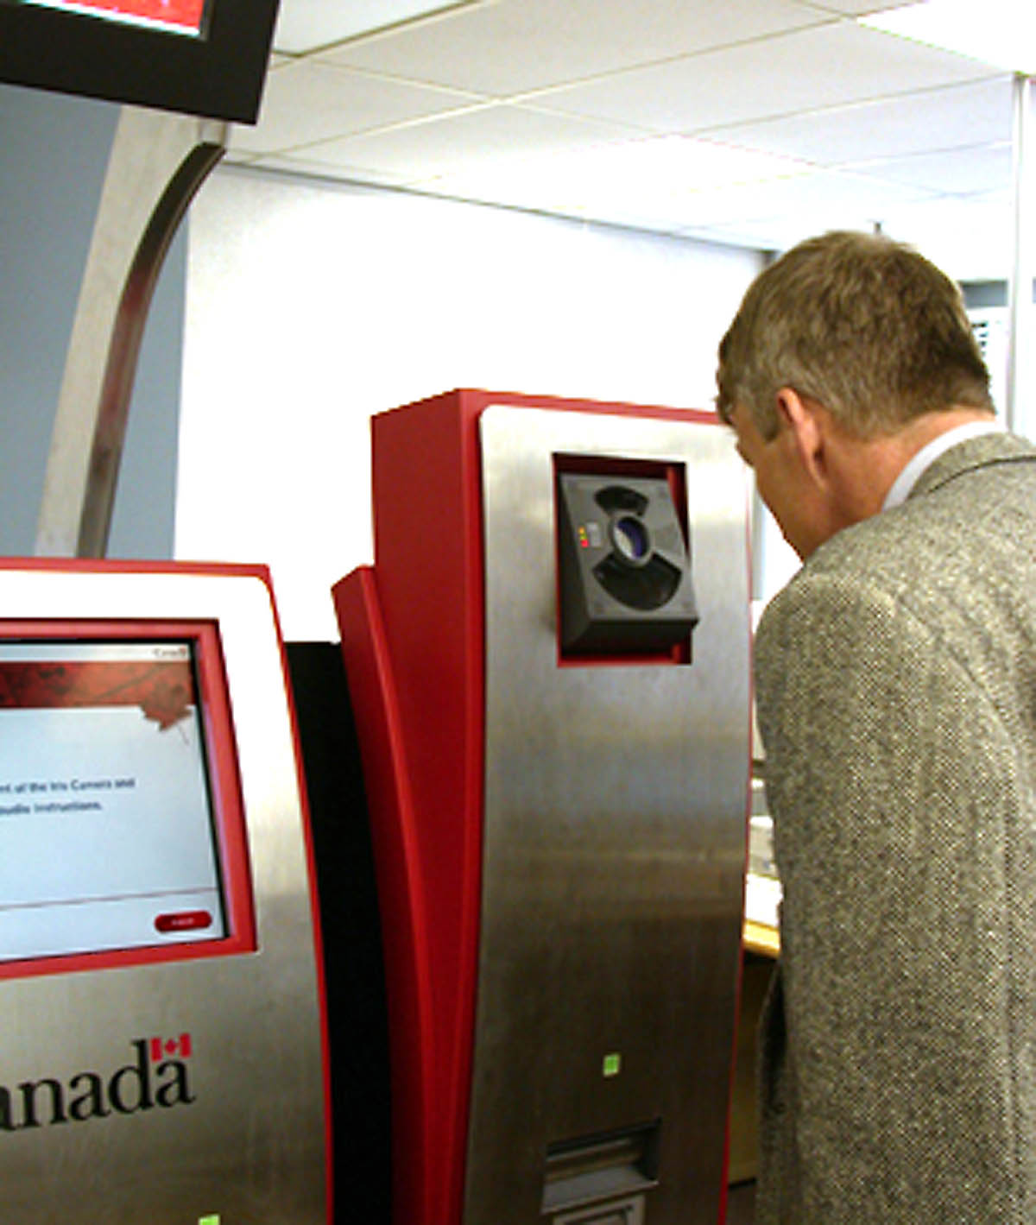
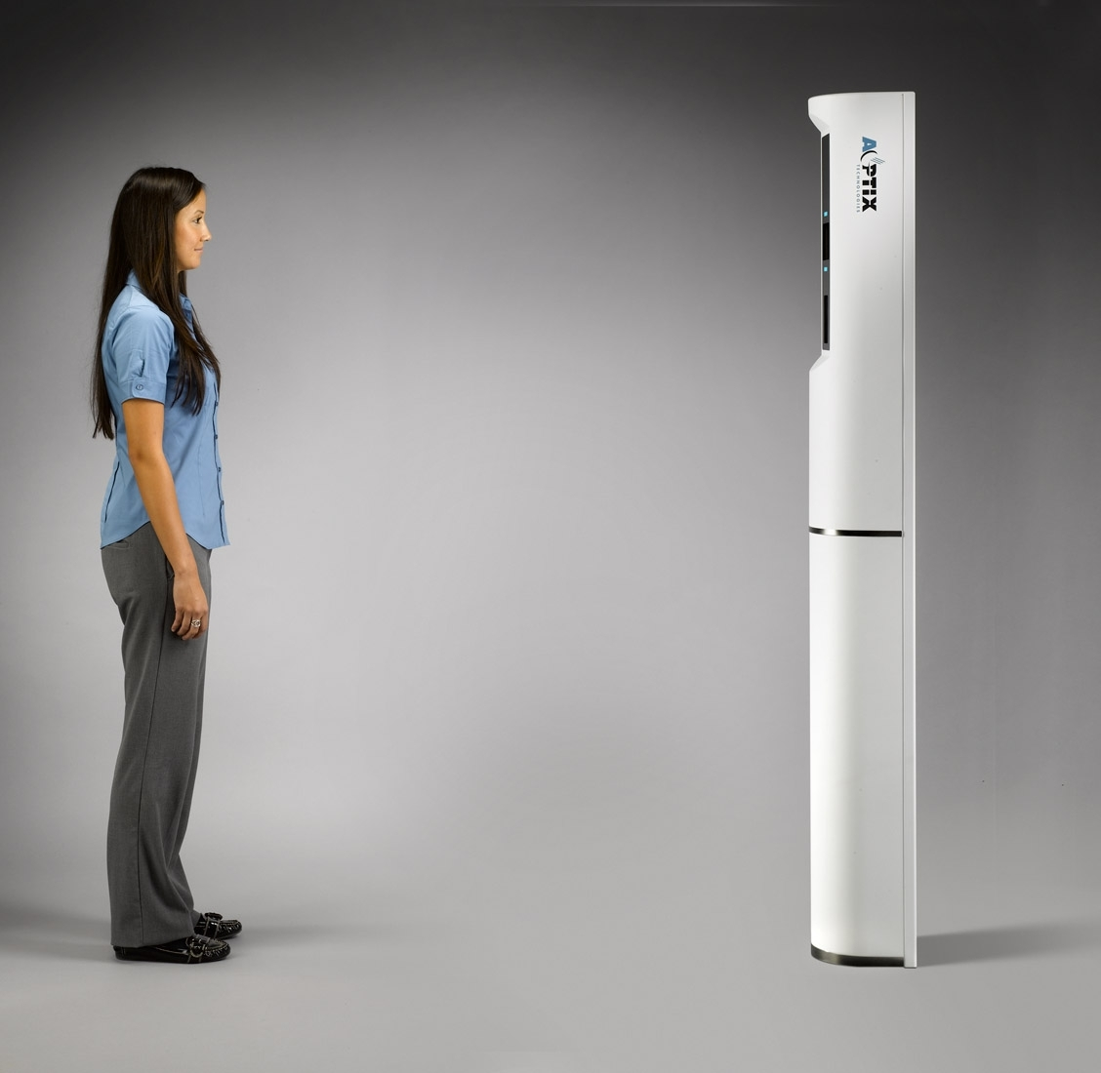
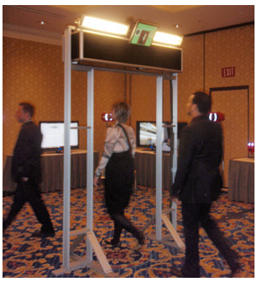
Hitherto, iris recognition has been restricted to close-range & well-controlled spaces
[CANPASS Air Iris Recognition System, biometricwatch.com, 2007]
[AOptix Technologies, Inc, asis.confex.com/asis/ansem2010/webprogram/Session24387.html]
[Hoyos Corp. & Stanley CSS demo., Photo by Geoff Kohl, Security InfoWatch, 2011]
Notes:
Despite the fact that iris recognition has been used successfully in close range and restricted environments, it has failed to gain wide scale adoption in large, open, unrestricted, public spaces.
The problem arises due to a fundamental limitation of all imaging systems—the depth of field (DOF)!

Slide 6
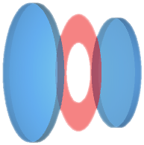
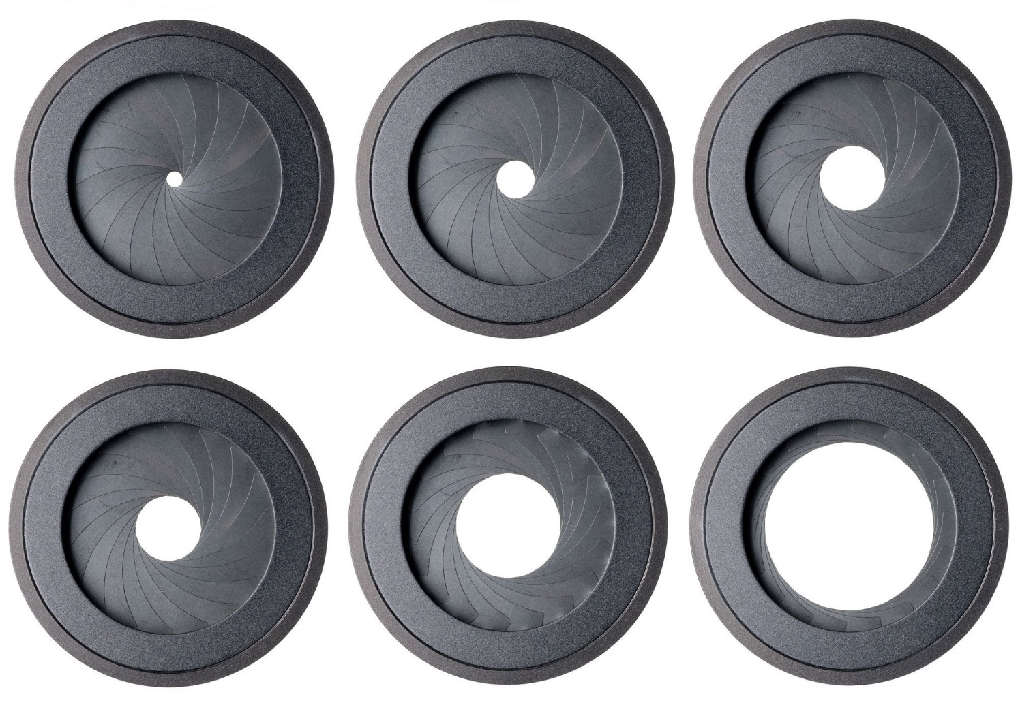

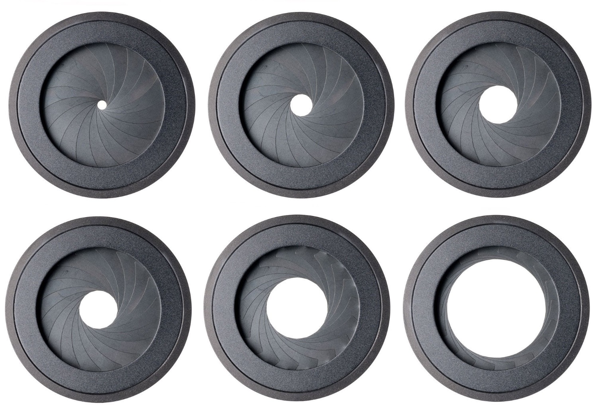
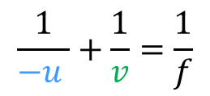

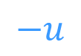
The depth of field (DOF) is the limited range of distances in the scene within which subjects appear sharp in the image
Lens elements
Aperture stop
Lens elements
Image plane
$$−u$$
$$v$$
DOF
$$\frac{1}{−u }+\frac{1}{v}=\frac{1}{f}$$
Plane of sharp focus (PoSF)
Gaussian formula:
Shallow DOF
Large DOF
F/5.6
F/8
F/11
F/16
F/22
Notes:
Here is a schematic of a typical lens-- consisting of elemental lenses on both sides of an aperture. The aperture is used to control the amount of light passing through the lens.
[Click]
The Gaussian lens formula, which we have all aware of, implies that only one plane in the object space can be in focus. Subjects away from the plane of sharp focus progressively begins to blur more and more.
[Click]
The range of distances in the object space within which subjects appear relatively sharp, is called the depth of field (DOF).
[Click]
In traditional cameras, the DOF is controlled by changing the size of the aperture. Larger apertures result in smaller DOF and smaller apertures result in larger DOF. The relative size of the apertures in a lens are designated using something called the F-number. Small F-number means larger aperture and shallow DOF, larger F-number means smaller aperture and larger DOF.
[I need to be very clear about mentioning that the F/# are ratios, the value depends on the diameter ]

Slide 7
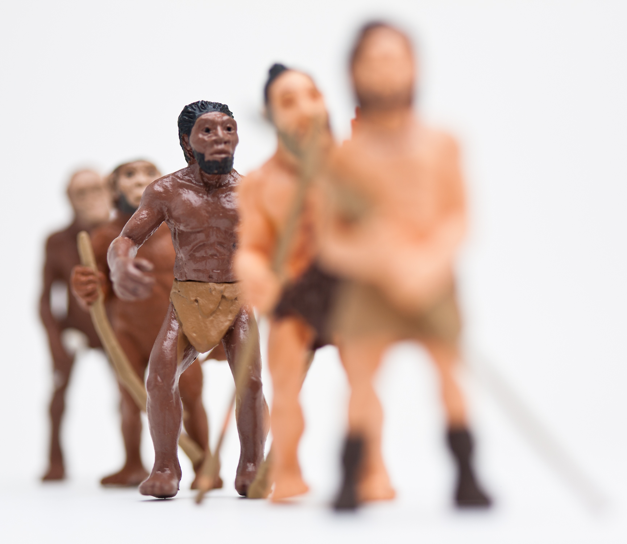
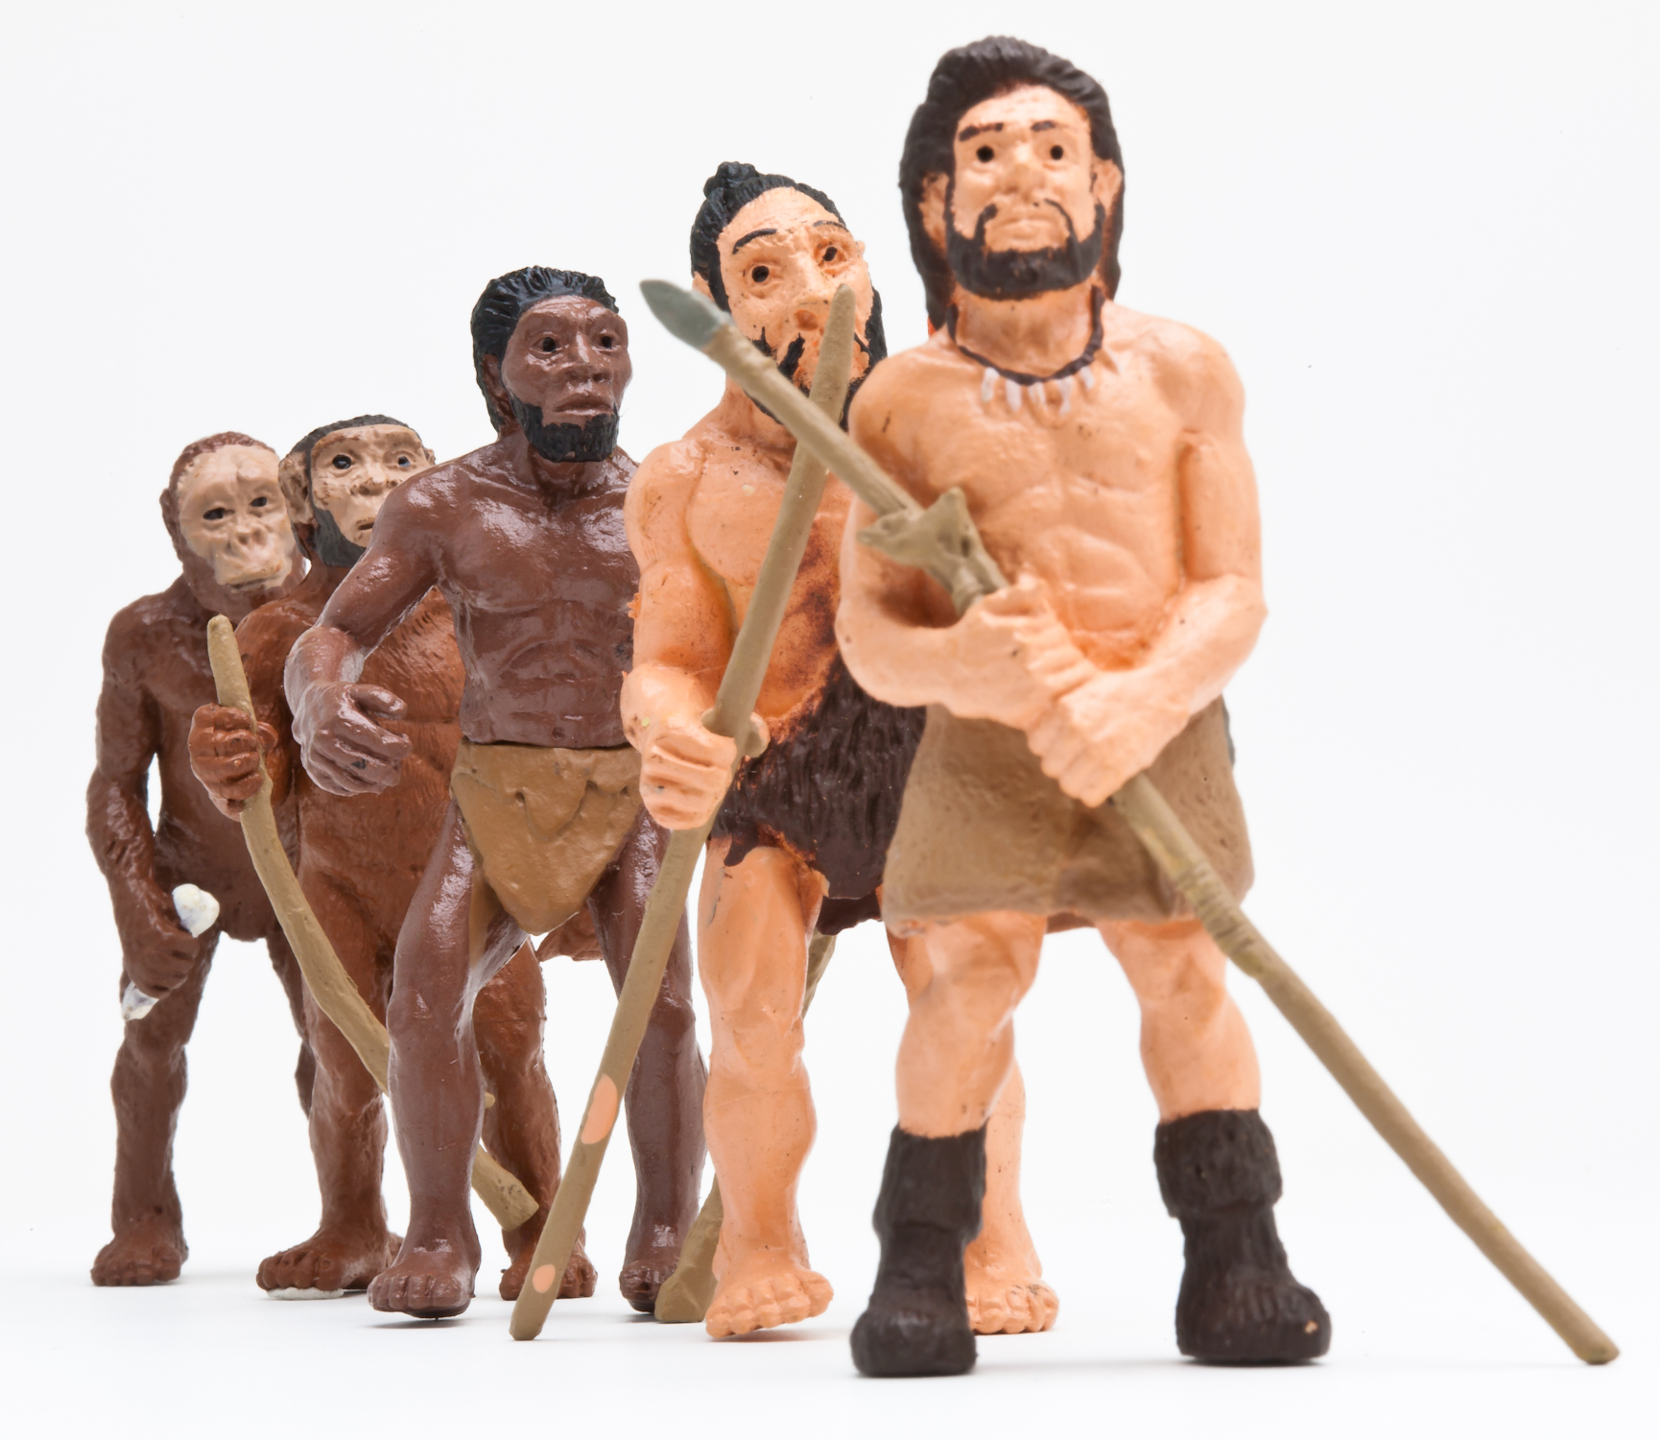
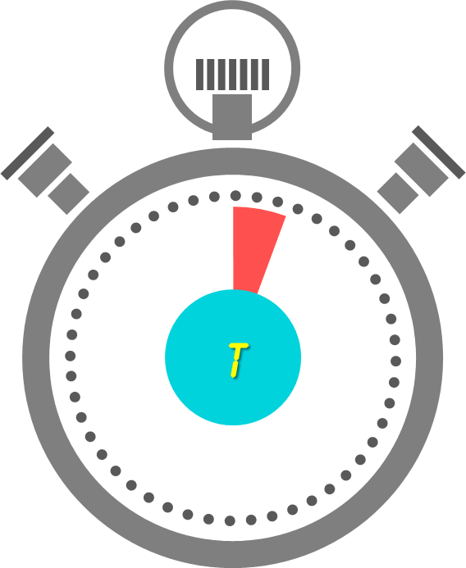
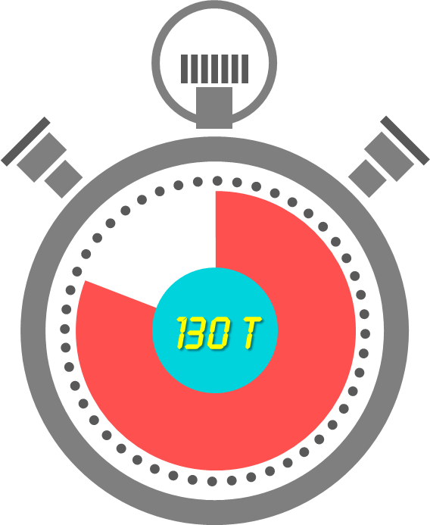
In traditional cameras the DOF is usually controlled by the aperture
Shallow DOF, aperture: F/2.8
Large DOF, aperture: F/32
Notes:
Here is an example of an image with very shallow DOF.
[Click]
And here is an image with a large DOF obtained by making the aperture smaller… reducing the area by almost a factor of 256.
But if we can get a large DOF by using a smaller aperture, then why don’t we use a small aperture for extending the DOF of iris recognition systems?
There are a number of reasons, and here is one:
[[The clocks appear]]
It took over two orders of magnitude more time to capture the image on the right. While that’s probably OK for inanimate beings, it is surely unacceptable for sentients going about their daily business. Moreover, we run into the typical tradeoff of optical imaging

Slide 8
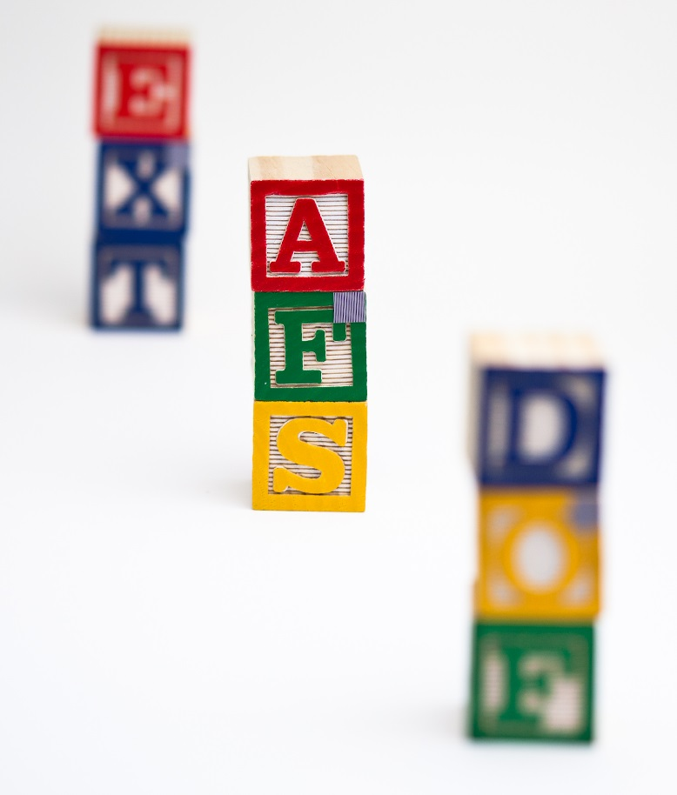
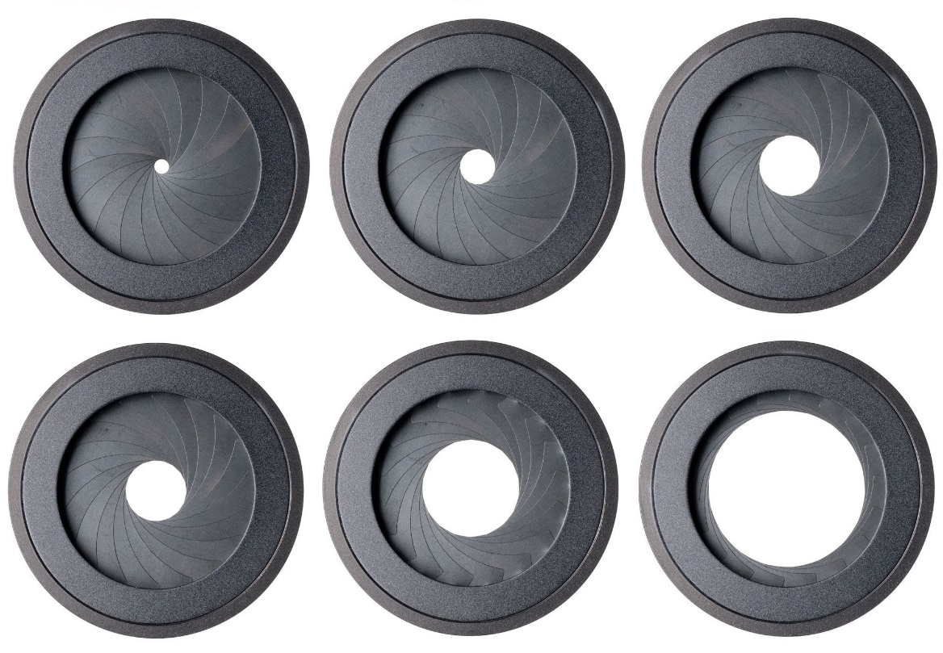
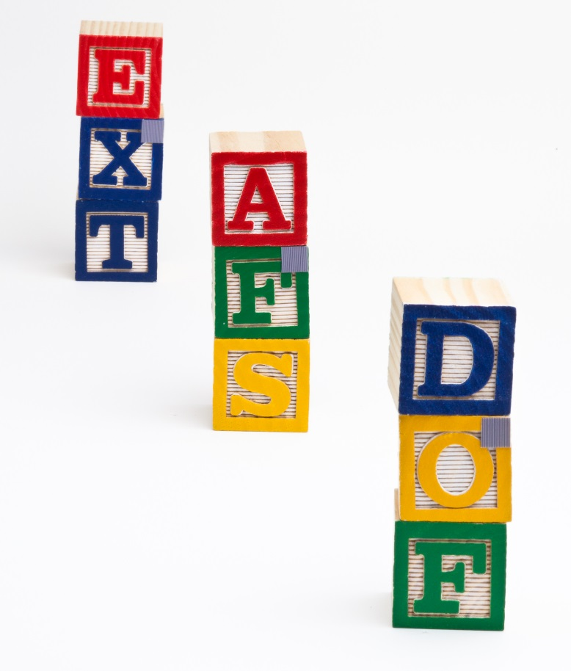
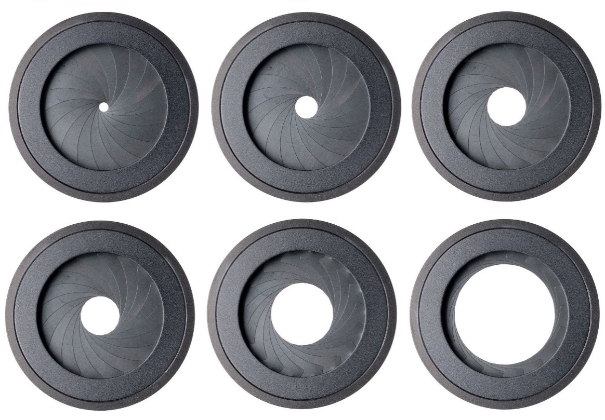



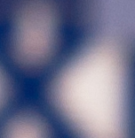
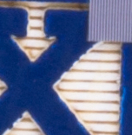
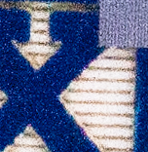
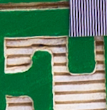
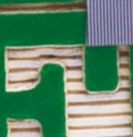
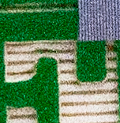
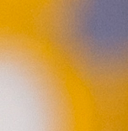
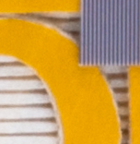
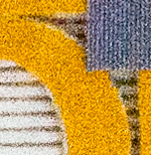
It is impossible to get high resolution, large DOF & high SNR simultaneously
in traditional imaging
Notes:
Here are three images of the same scene. The
The first one obtained with an large aperture.
[CLICK]
It has limited

Slide 9
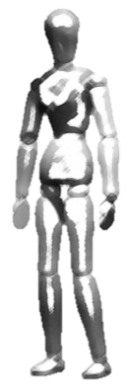
Increasing the DOF of the iris camera is an effective way of increasing the capture volume
L
Capture volume
W
H
Standoff distance
Notes:
The capture volume is the three dimensional region within which we can acquire high quality images of the iris suitable for iris recognition. The width and height of the capture volume is primarily determined by the field of view of the camera. Therefore, they can be increased by increasing the sensor dimensions. However, the only way to increase the capture volume axially along its length is by improving the DOF of the iris camera.
Note that the standoff distance can be improved by using a higher magnification lens.

Slide 10
Our goal in this work is to extend the capture volume of iris recognition systems
What is an ideal solution?
Extend the capture volume significantly (comparable or better than existing solutions)
Scalable
Low computational complexity for real time operation
Low cost
Notes:
State the goals here?

Slide 11

The original contributions of this thesis
Developed a pair of general imaging (geometric) models
Lens and the sensor planes can freely rotate about independent pivots
Incorporates the pupil parameters directly
A new computational imaging method for extending the depth of field of optical imaging systems
Conference paper on omnifocus image synthesis in Imaging and Applied Optics Congress 2016
Won Best Multimedia Award ( )
Journal paper submitted to OSA Applied Optics for special issue on Modern Imaging (currently in peer review process)
Software library for automating and externally controlling optical design and simulation tasks in Zemax
Invention disclosure (currently the patent is being written by a lawyer)
Notes:
In addition, I am currently working on two conference papers – one for the international conference on Computational Photography 2017, and the other for the IEEE International Joint Conference on Biometrics 2017,

Slide 13
Notes:
When we started looking into this problem, the first thing we did, as most researchers would do is look at the existing solutions.
Talk in brief about the existing solutions.
Talk about their disadvantages

Slide 14
Notes:
[Blank slide?]
After thinking about various ways to approach the problem, for example, using light field cameras, … we decided to invest on … scheimpflug princ…. Or using a scheimpflug camera.

Slide 15
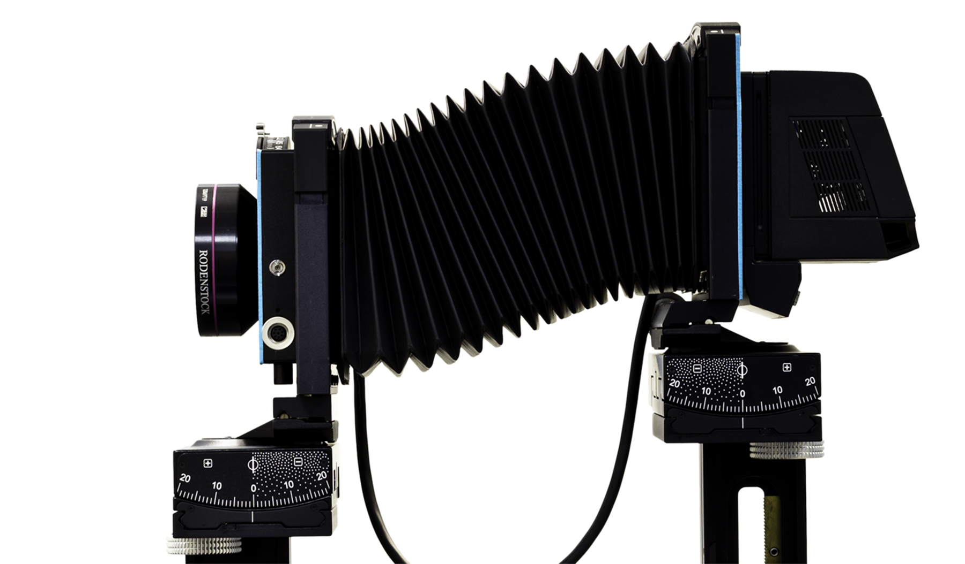
The lens & sensor in a Scheimpflug camera can rotate about independent pivots

Slide 16
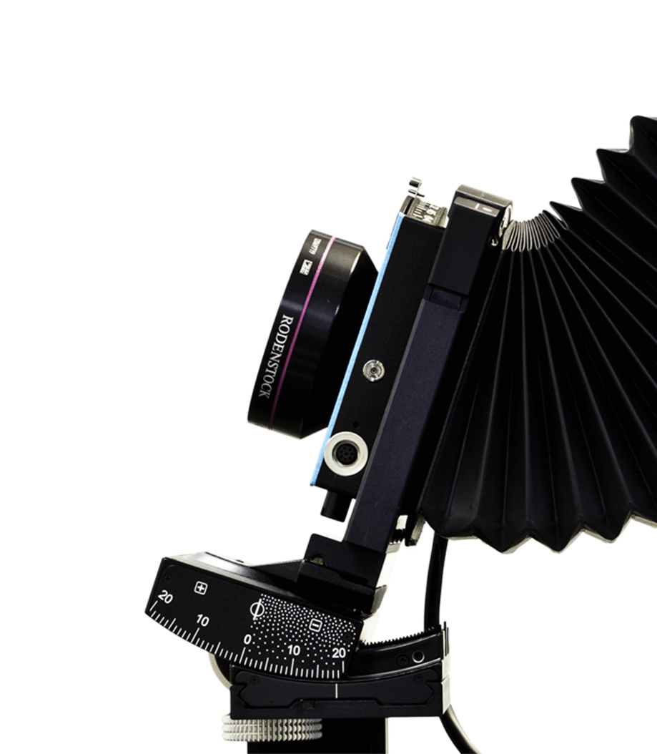
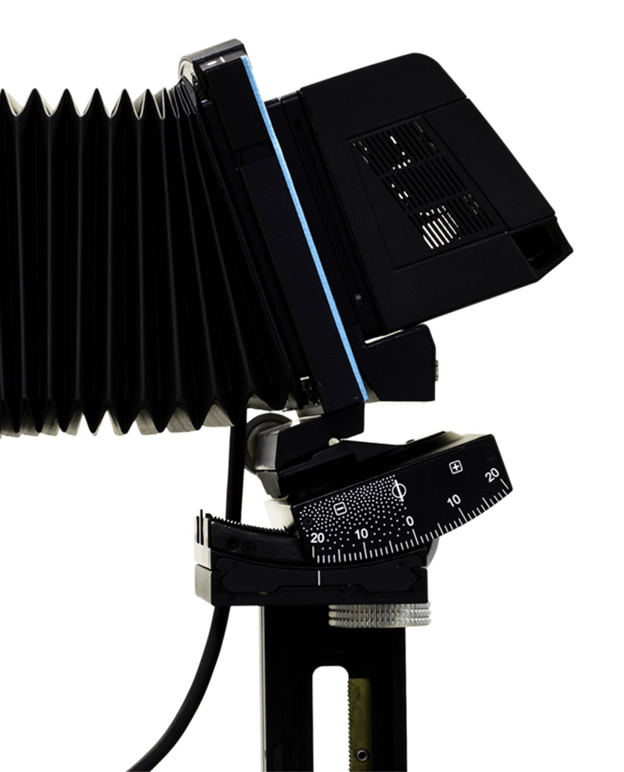
The lens & sensor in a Scheimpflug camera can rotate about independent pivots

Slide 17

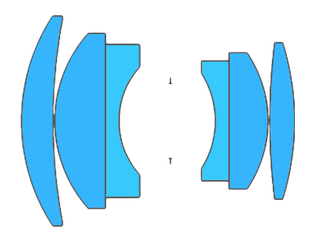
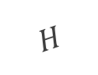
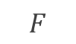
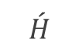



Scheimpflug principle: Rotating the lens or the sensor also rotates the plane of sharp focus
$$F$$
$$\acute{H}$$
$$H$$
$$F$$
$$\acute{H}$$
$$H$$
Sensor
Depth of field (DOF)
Optical axis
Optical axis
Sensor
Plane of sharp focus (PoSF)
Plane of sharp focus (PoSF)
Depth of field (DOF)

Slide 18
Notes:
[Blank??] Bought a Sinar camera … did experiments …. Saw problems

Slide 19




1
1
0.25 lp/mm
1.58 m
2
40 pixels across
13 line pairs
=> 45.14 lp/mm
2
8.1 m
0.5 lp/mm
Plane of Focus
4.1 m
3
3
1 lp/mm
4.1 m

Slide 20


1
1
0.25 lp/mm
1.58 m
2
2
8.1 m
0.5 lp/mm
3
3
40 pixels across
13 line pairs
=> 45.14 lp/mm
Plane of Focus
4
4.1 m
1 lp/mm
4
5
5
4.1 m

Slide 21




Slide 22



Center of entrance pupil
Optical axis
10 mm
32 mm
Lens pivot
Notes:
Problems ….
….From prior experience while setting up experiments for optical super-resolution in the lab, we attributed this distortion of the image to fact that the lens was not necessarily rotating about the center of the entrance pupil. Now, I haven’t explained what the entrance pupil is yet, so what is the center of the entrance pupil? Well, we will get to that in a minute. But for now, let me just say that we found this point … as shown in the figure. But, the lens in our camera always rotated about a different point. Therefore, every time we tilted the lens, the center of the entrance pupil would shift, and we had to do some adjustments—translations along the vertical and axial directions—to restore the position of the entrance pupil.
….but even when we rotated about the entrance pupil, we were observing a small shift of the image field. At that time, we weren’t really expecting this. In my prior experience during optical superresolution experiments in the lab, w The problem was we were never certain whether it was due to adjustment errors or it was for real.
…

Slide 23







Chief rays from the object space to the image space defines the image shape
Aperture (stop)
Image plane
Object
$$\text{x}$$
Chief ray
$$y_{o}$$
Optical axis
$$y_{i}$$
$$−u$$
$$v$$
Image
$$\acute{\text{x}}$$
Use of similar triangles:
$$m_{t}\text{(}\text{transverse} \text{magnification}\text{)}=\frac{y_{i}}{y_{o}}=\frac{v}{−u }$$
1
Notes:
The chief ray is the ray from the object point to the image point that passes through the center of the aperture. As seen in the figure, the intersection of the chief ray with the image plane determines the height of the image point. Therefore, for an extended object that consists of a set of points, the set of chief rays from the object space to the image plane determines the geometric properties of the image. We can find all relationships by applying similar triangles.
Furthermore, since all chief rays

Slide 24
Center of perspective: the chief rays from the object space converge at the center of the aperture
Aperture
Image plane
Chief rays
Object
Object
Image
Chief rays
Aperture
Image plane
Image
Notes:
The chief ray is the ray from the object point to the image point that passes through the center of the aperture. As seen in the figure, the intersection of the chief ray with the image plane determines the height of the image point. Therefore, for an extended object that consists of a set of points, the set of chief rays from the object space to the image plane determines the geometric properties of the image. We can find all relationships by applying similar triangles.
Furthermore, since the chief rays from the object converge at the center of the aperture, the center of the aperture is the “center of perspective projection” … in other words, if we change the location of the aperture’s center, a different set of rays from the object becomes the chief rays, and we

Slide 25

Real lenses have several refracting surfaces on either side of the aperture (stop)
Lens elements
in front of the aperture
Lens elements behind the aperture
Aperture
Cross-section of Zeiss Distagon 21mm F/2.8
[Photograph from ilovehatephoto.com]

Slide 26





xxxxxxx
Front view
+
Side view
$$E$$
Marginal ray
Aperture
Entrance pupil
$E$: center of the entrance pupil
Notes:
When we hold a magnifying glass over some text, the text looks magnified. Most of us will remember, the lens forms a virtual and enlarged image of the text behind the text. Similarly, when we place refracting elements in front of the aperture, we usually see a magnified image of the physical stop that is located behind the physical stop.
In the same way, when the chief rays from the

Slide 27




The “entrance pupil” is the image of the stop formed by the front lens elements
and the “exit pupil” is the image of the stop formed by the rear lens elements
Chief ray
Aperture (stop)
Object
Chief ray
Image
~361 mm
~144 mm
A double gauss lens (f = 102 mm) ▴
Exit pupil
Entrance pupil
Chief ray
Stop
Center of entrance pupil ($E$)
Center of exit pupil ($\acute{E}$)
Notes:
Here is a widely popular lens design called the Double Gauss, with a few rays traced from the two extreme points of an object. The image shows the chief rays, the marginal rays, and the lens consisting of refracting elements in front and behind the aperture.
The zoomed in figure shows the location of the entrance pupil, which is the image of the aperture formed due to the lens elements on the object side, and the exit pupil, which is the image of the aperture formed due to the lens elements on the image side. I found the locations and the size of the images using Zemax.
Furthermore, if we concentrate on the chief rays, we can see that the chief rays from the object side entering the lens appear to converge towards the center of the entrance pupil, and the corresponding chief rays going away from the lens towards the image plane, appear to diverge from the center of the exit pupil.
Now, because the angle of the chief ray going towards the image plane will determine the height—and therefore the geometric properties—of the image, a question to ask is whether the chief ray entering the lens and and the corresponding chief ray exiting the lens are parallel?

Slide 28






















Nothing in optics makes sense except in the light of the pupils
Exit pupil
Entrance pupil
Chief ray (input)
$$h_{e}$$
$$\acute{h_{e}}$$
$$\text{x}$$
$$l$$
$${\hat{c}}_{y}$$
$$ω$$
$$E$$
$$\left\{C\right\}$$
$$\acute{E}$$
Optical axis
$${\hat{c}}_{z}$$
$$\acute{ω}$$
$$\acute{l}$$
Chief ray (output)
Lens pivot & origin of camera coordinate frame
$$d_{e}$$
$$\acute{d_{e}}$$
$$z$$
Pupil magnification:
$$c$$
Direction cosine
$$b$$
$$m_{p}=\frac{{\acute{h}}_{e}}{h_{e}}$$
$$y$$
2
$$a$$
$$l= <\cos{a},\cos{b},\cos{c}>$$
$$x$$
Notes:
But before we get there, lets introduce … how w
Talk about the abstraction of lens, and the pupil magnification.

Slide 29











The pupil magnification $m_{p}$ changes the chief ray’s direction cosine
in the image space
Exit pupil
Entrance pupil
Chief ray
$$\text{x}$$
$${\hat{c}}_{y}$$
$$l$$
$$\acute{E}$$
$$\left\{C\right\}$$
$$\acute{ω}$$
$$α_{ }$$
$$ω$$
$${\hat{c}}_{z}$$
$$E$$
Optical axis
$$\acute{l}$$
Lens pivot & origin of camera coordinate frame
$$\acute{l}=\frac{1}{\sqrt{1+\left(m_{p}^{2}−1\right)n_{R}^{2}}}{}_{ }^{ }{R_{𝓁}}M_{p}R_{𝓁}^{T}l$$
Chief ray’s direction cosine at the input (object space)
Chief ray’s direction cosine at the output (image space)
3
$n_{R}=r_{𝓁,3}^{T}l$, ${ M}_{p}=diag(1, 1, m_{p})$
Notes:
The first step in bu
.. The pivot of the lens is the center of the camera coordinate system
Notice that the output direction cosine of the chief ray is unmodified if the pupil magnification is unity.

Slide 30




















Image-object relationship for arbitrarily oriented lens and sensor rotations
Exit pupil
$${\hat{n}}_{i}$$
Chief ray
Pivots
Entrance pupil
$$\text{x}$$
$${\hat{c}}_{y}$$
$$\acute{E}$$
$${\hat{i}}_{y}$$
$$l$$
$${\hat{i}}_{x}$$
$$\left\{C\right\}$$
$$\acute{ω}$$
$$α_{ }$$
$$ω$$
$${\hat{c}}_{z}$$
$$\left\{I\right\}$$
$$E$$
$$\acute{l}$$
Optical axis
$$\acute{\text{x}}$$
$${\acute{d}}_{e}^{ }$$
$$d_{e}$$
$${\acute{z}}_{o}^{ }$$
Image plane
$$\begin{aligned}{}_{ }^{I}{\acute{\text{x}}}=&{R_{i}}^{T}\left({\acute{d}}_{e} r_{𝓁,3}−t_{i}\right)+\frac{\left({\hat{n}}_{i}\left(3\right){\acute{z}}_{o}−{\acute{d}}_{e}{\hat{n}}_{i}^{T} r_{𝓁,3}\right)}{{\hat{n}}_{i}^{T}R_{𝓁}M_{p}R_{𝓁}^{T}\left({}_{ }^{c}{\text{x}}−d_{e} r_{𝓁,3}\right)}{}_{ }^{ }{{R_{i}}^{T}R_{𝓁}}M_{p}R_{𝓁}^{T}\left({}_{ }^{c}{\text{x}}−d_{e} r_{𝓁,3}\right)\end{aligned}$$
4
Coordinates of image point in image reference frame
Coordinates of object point in camera frame
Notes:
… then we introduce an sensor plane, that can rotate about its independent pivot (at a distance z_o dash) from the pivot of the lens.
The pupil coordinates are highlighted in red

Slide 31









Comparing image coordinates obtained numerically against Zemax’s ray traced values for randomly parameterized systems proved the accuracy of the model
Object plane
Lens 2, $f$ = 30 mm
Image plane
Chief rays
Lens 1, $f$ = 40 mm
Optical axis
Stop
y
x
Entrance pupil
$z_{o}$= -509 mm
z
Exit pupil
$\acute{z_{o}}$ = 24.17 mm
Lens parameters:
$d_{e}$ = -5 mm
$\acute{d_{e}}$= -25 mm
$f_{eff}$ = 24 mm
$m_{p}$= 2.0
Lens rotation parameters:
$α_{x}$ = -20°, $α_{y}$ = 10°
Sensor rotation parameters:
$β_{x}$ = 15°, $β_{y}$ = -5°

Slide 32

Comparing image coordinates obtained numerically against Zemax’s ray traced values for randomly parameterized systems proved the accuracy of the model
World point ${}_{ }^{C}{\text{x}} (x, y, z)$ | Computed image point ${}_{ }^{I}{\acute{\text{x}}}(\acute{x}, \acute{y}, \acute{z})$ | Ray-traced image point ${{}_{ }^{I}{\acute{\text{x}}}}_{rt}(\acute{x}, \acute{y}, \acute{z})$ | Absolute difference $\left|{}_{ }^{I}{\acute{\text{x}}}−{{}_{ }^{I}{\acute{\text{x}}}}_{rt}\right|$
( 0.0, 0.0, -509.0) | (-0.3108, -0.6291, 0.0) | (-0.3108, -0.6291, 0.0) | (1.8e-09, 3.1e-09, 7.5e-15)
(10.0, -10.0, -509.0) | (-0.8003, -0.0863, 0.0) | (-0.8003, -0.0863, 0.0) | (2.1e-09, 2.7e-09, 3.0e-15)
(-50.0, 50.0, -509.0) | (2.1291, -3.3352, 0.0) | (2.1291, -3.3352, 0.0) | (1.2e-09, 3.2e-09, 2.9e-15)
(70.71, 70.71, -509.0) | (-4.2013, -5.0221, 0.0) | (-4.2013, -5.0221, 0.0) | (2.6e-09, 5.1e-09, 4.7e-15)
(100.0, 0.0, -509.0) | (-5.5251, -1.0101, 0.0) | (-5.5251, -1.0101, 0.0) | (1.3e-09, 8.4e-09, 3.1e-15)
( 0.0, 100.0, -509.0) | (-0.6031, -6.4387, 0.0) | (-0.6031, -6.4387, 0.0) | (2.2e-09, 4.0e-09, 2.2e-16)
(100.0, 100.0, -509.0) | (-5.8238, -6.8542, 0.0) | (-5.8238, -6.8542, 0.0) | (5.6e-10, 2.5e-10, 2.2e-15)
Notes:
Note that Zemax doesn’t solve any alalytic equation like we did to find the image coordinates like we did. Instead, Zemax traces rays following the laws of optics, especially the vector form of Snell’s laws. Ofcourse, the roots of our model can be traced back to the snell’s laws. Therefore, we expect, if our model is accurate, the results obtained through two completely different processes should match.

Slide 33















Image distortion due to lens rotation depends on: (a) the distance of the point of rotation from the entrance pupil center, and (b) the pupil magnification $m_{p}$
Far plane
Near plane
$${\hat{n}}_{i}$$
Exit pupil
Entrance pupil
$${\hat{c}}_{y}$$
$$\acute{E}$$
$${\hat{i}}_{y}$$
Setup
$$\left\{C\right\}$$
$${\hat{i}}_{x}$$
Optical axis
$${\hat{c}}_{z}$$
Image plane
$$E$$
w
$${\acute{d}}_{e}^{ }$$
2w
-$z$
$$d_{e}$$
$${\acute{z}}_{o}^{ }$$
-$2z$
2w
w
Image plane
Notes:
Explain the setup…
Although, a more extensive analysis is presented in the thesis, due to interest of time we are going to examine only three rows: the top, middle and bottom rows of the images from the two grids.

Slide 34











Image distortion due to lens rotation depends on: (a) the distance of the point of rotation from the entrance pupil center, and (b) the pupil magnification $m_{p}$
$$m_{p}=0.55$$
$$m_{p}=1.0$$
$$m_{p}=2.0$$
$$d_{e}=−5 mm$$
(a)
(b)
(c)
$$d_{e}=0$$
(d)
(e)
(f)
Notes:
The important take away here are:
The rotation of the lens causes a shift and distortion of the image field. The exact nature of the distortion depends on the location of the lens’s pivot point with respect to the center of the entrance pupil and secondly the pupil magnification.

Slide 35





















Focusing equation for arbitrarily oriented lens and image planes
Exit pupil
$${\hat{n}}_{i}$$
Chief ray
Pivots
$${\hat{n}}_{o}$$
Entrance pupil
$$\text{x}$$
$${\hat{c}}_{y}$$
$${\hat{i}}_{y}$$
$$l$$
$$\acute{E}$$
$$\left\{C\right\}$$
$${\hat{i}}_{x}$$
$${\hat{c}}_{z}$$
Optical axis
$$E$$
$$\acute{l}$$
$$\acute{\text{x}}$$
$${\acute{d}}_{e}^{ }$$
$$d_{e}$$
$$z_{o}^{ }$$
$${\acute{z}}_{o}^{ }$$
Object plane
Image plane
Object orientation: ${\overset{̰}{\hat{n}}}_{o}$
$$−\frac{{\overset{̰}{\hat{n}}}_{o}}{m_{p}\left[z_{o}−d_{e}\left({\overset{̰}{\hat{n}}}_{o}^{T}r_{𝓁,3}\right)\right]}+\frac{R_{𝓁}M_{p}R_{𝓁}^{T}{\overset{̰}{\hat{n}}}_{i}}{\left[{\acute{z}}_{o}−{\acute{d}}_{e}\left({\overset{̰}{\hat{n}}}_{i}^{T}r_{𝓁,3}\right)\right]}=\frac{r_{𝓁,3} }{f}$$
where,
${\overset{̰}{\hat{n}}}_{o}=\frac{{\hat{n}}_{o}}{\left.{\hat{n}}_{o}(3\right)}$ ; ${\overset{̰}{\hat{n}}}_{i}=\frac{{\hat{n}}_{i}}{\left.{\hat{n}}_{i}(3\right)}$
Sensor orientation: ${\overset{̰}{\hat{n}}}_{i}$
5
Lens orientation: $R_{𝓁}$, $r_{𝓁,3}$
Notes:
Following similar steps as before, and using the constraint that the projection of any chief ray on the optical axis in the object and image side must satisfy the Gaussian equation.

Slide 36













Focusing relations for specific configurations can be derived from the general equation: tilting a lens about its entrance pupil to focus on a tilted object plane
Object plane
$$β$$
$$α$$
$${\hat{c}}_{y}$$
Lens plane
$$\acute{E}$$
z - axis
$${\hat{c}}_{z}$$
$$O$$
$$E$$
$$d$$
Image Plane
Optical axis
Entrance pupil
$$z_{o}$$
$$\acute{z_{o}}$$
$$(−)$$
$${\acute{z}}_{o}=d\cos{α}+\frac{m_{p}z_{o}f\left(m_{p}\cos^{2}{α}+\sin^{2}{α}\right) }{m_{p}z_{o}\cos{α}+f}$$
6
$$\tan{β}=−\frac{\sin{α}\left[m_{p}z_{o} +f\left(1−m_{p}\right)\cos{α}\right] }{f\left(m_{p}\cos^{2}{α}+\sin^{2}{α}\right) }$$
7
Notes:
I have discussed few standard configurations in the thesis. There relation shown here is for the case that were are going to make use of immediately,
Verification for the specific case.

Slide 37

The table demonstrates that the values of object plane tilt angle $β$ and image plane distance ${\acute{z}}_{o}$ in Zemax match the numerically computed values
Ray traced values (Zemax)
Numerically computed
$β$ (Zemax)¹ | $α$ (Zemax)² | $\acute{z_{o}}$ (Zemax)³ | $β$ (numerical)⁴ | $\acute{z_{o}}$ (numerical)⁵
0.0° | 0.0° | 29.17073 mm | -2.2e-15° | 29.17073 mm
-10.0° | -0.46989° | 29.17145 mm | -10.0° | 29.17145 mm
25.0° | 1.24249° | 29.17572 mm | 25.0° | 29.17572 mm
-40.0° | -2.23504° | 29.18687 mm | -40.0° | 29.18687 mm
65.0° | 5.69682° | 29.27607 mm | 65.0° | 29.27607 mm
-80.0° | -14.79587° | 29.90304 mm | -80.0° | 29.90304 mm
Object plane ($z_{o}=−504.0$ mm) tilt $β$ set in Zemax. Lens plane tilt $α$ obtained using optimization using ray-tracing in Zemax. Image plane distance ${\acute{z}}_{o}$ obtained using optimization using ray-tracing in Zemax. Object plane tilt $β$ computed numerically using the value of $α$ in column 2. Image plane distance ${\acute{z}}_{o}$ computed numerically using the value of $α$ in column 2.

Slide 38



We can orient the plane of sharp focus & the DOF in Scheimpflug camera,
approximated as a wedge,
Depth of field (DOF)
$$F$$
$$\acute{H}$$
$$H$$
Sensor
Optical axis
Plane of sharp focus (PoSF)
Notes:
Now that we know how to orient the plane of sharp focus along a desired orientation,
NOTE: I think that the wedge approximation is true for a set spatial frequency limit on the image plane …. However, if we desire a target spatial frequency in the object space, then the region is not really a wedge extending away from the camera, …. But the shape shrinks as we go from the camera.

Slide 39
Synthesis of extended DOF in traditional photography using focus stacking
Depth of Field
Depth of Field
Depth of Field
Depth of Field
Depth of Field
DEEP OBJECT SPACE
Sensor
Sensor
Sensor
Sensor
Sensor
Plane of sharp focus
Plane of sharp focus
Plane of sharp focus
Plane of sharp focus
Plane of sharp focus
Notes:
In fact there is a similar technique in conventional photography, called focus stacking.

Slide 40










Synthesis of extended DOF in traditional photography using focus stacking
Sensor image 1/3
Sensor image 2/3
Sensor image 3/3
Lens
64 mm
$z$-axis
Sensor plane
Focus measure (LoG)
Focus measure (LoG)
89 mm
200 mm
Focus measure (LoG)
200 mm
1000 mm

Slide 41




Synthesis of extended DOF in traditional photography using focus stacking
Registration
Blending
Composite image
$$H_{3×3}^{−1}(p)$$
$$H_{3×3}^{−1}(p)$$
Focus measure (LoG)

Slide 42
So here is the idea …
Plane of sharp focus
Plane of sharp focus
Plane of sharp focus
Plane of sharp focus
Plane of sharp focus
DEEP OBJECT SPACE
Sensor

Slide 43
Notes:
[Blank] But I began to wonder, why doesn’t such a method already exist?

Slide 44











Setup of Zemax simulation to verify the theory of angular focus stacking (AFS) to extend the DOF
Lens rotated by 0° about ENPP
Lens rotated by -$α$° about ENPP
Lens rotated by $α$° about ENPP
Sensor image 1/13 ( 0°)
Sensor image 7/13 ( -8°)
Sensor image 13/13 (8°)
Lens ( $m_{p}$=1)
Paraxial thick-lens model with spherical aberration;
$f$ = 24 mm, F/2.5
Lens ( $m_{p}$=1)
Paraxial thick-lens model with spherical aberration;
$f$ = 24 mm, F/2.5
Setup
Lens ( $m_{p}$=1)
Paraxial thick-lens model with spherical aberration;
$f$ = 24 mm, F/2.5
Setup
Setup
1/2
1/2
1/2
64 mm
64 mm
64 mm
$z$-axis
$z$-axis
$z$-axis
Sensor plane
Sensor plane
Sensor plane
6 x 5 sq. mm, 1.78 $μm$
6 x 5 sq. mm, 1.78 $μm$
6 x 5 sq. mm, 1.78 $μm$
89 mm
89 mm
89 mm
200 mm
200 mm
200 mm
1/2
1/2
1/2
1000 mm
1000 mm
200 mm
1000 mm
200 mm
200 mm
Focus measure (LoG)
Focus measure (LoG)
Focus measure (LoG)

Slide 45
The inter-image homography is the geometric mapping between corresponding points in the images in the angular focal stack
Sensor image 1/13 ( 0°)
Sensor image 7/13 ( -8°)
?
1/2
1/2
Notes:
The question that we are interested in asking is how is one image geometrically related to another image in the stack?
… we found out that such a relation exist only if the lens is rotated about the center of the entrance pupil. Furthermore, if the pupil magnification is unity, then

Slide 46













The focal stack of 13 images for lens tilts between -8° and 8°
Refrence image

Slide 47



The inter-image homography is the geometric mapping between corresponding points in the images in the angular focal stack
$$\begin{aligned}{}_{ }^{I}{\acute{\text{x}}}=&{R_{i}}^{T}\left({\acute{d}}_{e} r_{𝓁,3}−t_{i}\right)+\frac{\left({\hat{n}}_{i}\left(3\right){\acute{z}}_{o}−{\acute{d}}_{e}{\hat{n}}_{i}^{T} r_{𝓁,3}\right)}{{\hat{n}}_{i}^{T}R_{𝓁}M_{p}R_{𝓁}^{T}\left({}_{ }^{c}{\text{x}}−d_{e} r_{𝓁,3}\right)}{}_{ }^{ }{{R_{i}}^{T}R_{𝓁}}M_{p}R_{𝓁}^{T}\left({}_{ }^{c}{\text{x}}−d_{e} r_{𝓁,3}\right)\end{aligned}$$
4
For roation of a unit pupil magnification lens about the $x$-axis by angle $α$
$$\underset{{}_{ }^{I}{\acute{\text{x}}}}{\underbrace{\left[\begin{matrix}{}_{ }^{I}{\acute{x}} \\ {}_{ }^{I}{\acute{y}} \\ 1\end{matrix}\right]}}=\underset{ A\left(α\right)}{\frac{1}{{}_{ }^{C}z} \underbrace{\left[\begin{matrix}\left({\acute{z}}_{o}−d\cos{α}\right) & 0 & 0 \\ 0 & \left({\acute{z}}_{o}−d\cos{α}\right) & −d\sin{α} \\ 0 & 0 & 1\end{matrix}\right]}} \underset{{}_{ }^{C}{\text{x}}}{\underbrace{\left[\begin{matrix}{}_{ }^{C}x \\ {}_{ }^{C}y \\ {}_{ }^{C}z\end{matrix}\right]}}$$
8
Two images obtained under lens rotations $α_{1}$ and $α_{2}$ can be related as:
$${{}_{ }^{I}{\acute{\text{x}}}}_{α_{2}}=\underset{\left.H(α_{2}, α_{1}\right)}{\underbrace{A\left(α_{2}\right) {A\left(α_{1}\right)}^{−1}}}{ {}_{ }^{I}{\acute{\text{x}}}}_{α_{1}}$$
9
$$H\left(α_{2},α_{1}\right)=\left[\begin{matrix}\frac{{\acute{z}}_{o}−d\cos{α_{2}}}{{\acute{z}}_{o}−d\cos{α_{1}}} & 0 & 0 \\ 0 & \frac{{\acute{z}}_{o}−d\cos{α_{2}}}{{\acute{z}}_{o}−d\cos{α_{1}}} & \frac{d}{p}\left(\frac{{\acute{z}}_{o}\left(\sin{α_{1}}−\sin{α_{2}}\right)−d\sin\left(α_{1}−α_{2}\right)}{{\acute{z}}_{o}−d\cos{α_{1}}}\right) \\ 0 & 0 & 1\end{matrix}\right]$$
10
Notes:
The question that we are interested in asking is how is one image geometrically related to another image in the stack?
… this is called the inter-image homography.
We found out that such a relation—the inter-image homography—exist only if the lens is rotated about the center of the entrance pupil. Furthermore, if the pupil magnification is one, then the transformation greatly simplifies to a simple scaling and transverse shift.

Slide 48












The composite image shows all the planes in sharp focus
Registration
Blending
Composite image
$$H_{3×3}^{−1}(α)$$
$$⋮$$
$$⋮$$
Focus measure (LoG)
$$⋮$$
$$⋮$$
$$H_{3×3}^{−1}(α)$$

Slide 49
Notes:
[Blank slide] … preptalk about the experiment …

Slide 50





Demonstration of capture volume improvement using AFS in the laboratory
0.61 m
0.61 m
4.04 m
Setup #1
rear
middle
180 mm, F/8
near
Artificial iris
3.43 m
4.04 m
4.65 m
Ø 11 mm
Camera’s view
Pattern (2 lp/mm)
mm

Slide 51





Traditional image capture with large aperture results in shallow DOF
Aperture: F/8 Exposure time: 0.77 sec Focused on: 4.04 m DOF: approx. 30 cm (for 2 lp/mm)
3.43 m
4.04 m
4.65 m
Focus measure
Notes:
Mention that the patches has been scaled differently to match ???

Slide 52
Strategy for capture AFS images
180 mm, F/8 lens tilted b/w -16° & -19° in increments of 0.5° about the entrance pupil center
Notes:
How to determine the angles
How to determine the image plane distance
How to determine
A line on how to restore the COP …
Empirically we found d = -5

Slide 53














Focused regions in the images detected using LoG filter shows different regions of the scene in focus
$$α=−{16.0}^{o}$$
$$α=−{16.5}^{o}$$
$$α=−{17.0}^{o}$$
$$α=−{17.5}^{o}$$
$$α=−{18.0}^{o}$$
$$α=−{18.5}^{o}$$
$$α=−{19.0}^{o}$$
Notes:
Mention that these are “registered” images in the focal stack

Slide 54

The focused regions overlaid on intensity images shows
rotating the lens induces a rotation of the DOF in the object space

Slide 55





AFS composite image shows DOF extended beyond 1.2 meters
Aperture: F/8 (each image) Total exposure time: 5.4 sec DOF: greater than 1.2 m (for 2 lp/mm)
3.43 m
4.04 m
4.65 m
Focus measure
Adjustment errors causes registration errors
Notes:
Talk about the registration errors arising from the uncertainties of the experiment.

Slide 56

AFS produces at least 4x more DOF than conventional imaging
for a r_{o} = 2 lp/mm target at 4 m
Near (3.43 m)
Middle (4.04 m)
Far (4.65 m)
Conventional at F/8
DOF (r_{o}) = 29 cm
AFS
DOF (r_{o}) $≥$ 1.2 m
Notes:
Mention that the patches has been scaled differently to match ???

Slide 57

AFS is faster than conventional capture for equivalent DOF & exposure level. Therefore, subjects are less constrained within the extended capture volume.
Near (3.43 m )
Middle (4.04 m )
Far (4.65 m )
Conventional at F/22
T = 8 sec.
AFS
Total T = 5 sec.
Each T = 0.77 sec.
Notes:
Since the main comparision here is for the total time … I can probably scale the images of the eye patches

Slide 58



Could we push a
0.61 m
0.61 m
0.61 m
0.61 m
4.04 m
3.43 m
Setup #2
Setup #1
rear
middle
near
180 mm, F/8
rear
middle
near
3.43 m
4.04 m
2.82 m
Artificial iris
Ø 11 mm
Camera’s view
Pattern (3.94 lp/mm)

Slide 59







AFS with 14 focal stack images resulted 9.8x DOF than conventional imaging
for a r_{o} = 3.94 lp/mm target at 3.43 m
Middle (3.43 m)
Far (4.04 m)
Near (2.82 m)
Conventional at F/8
DOF (r_{o}) = 12.5 cm
AFS*
DOF (r_{o}) $≥$ 1.2 m
*In this example, the focal stack images, after registration, were fused using Helicon focus.
Notes:
Mention that the patches has been scaled differently to match ???

Slide 60


Automatic registration and image fusion fails if the lens is not rotated about the center of the entrance pupil
Output of Helicon focus

Slide 61
Notes:
Advantages of focus stacking method over current methods

Slide 62
Notes:
Original contributions again

Slide 63
Notes:
acknowledgements

Slide 64








The DOF is a result of how the incoherent 3D PSF spreads out in space
5%
1%
1300 mm
108.33 mm
80%
18 mm
25 mm
20%
B
A
C
100 mm, F/5
C’
A’
B’
▴ Imaging system
▴ 3D Incoherent PSF
DOF
B’
A’
C’
▴ Object space
▾ 2D PSF
▾ Iris in object space
B/A/C
B’
A’
C’
▾ Image (simulation)
Notes:
Briefly explain what is the main cause of this limitation (DOF)
The impulse for the 3 configurations
Explain the 3-D incoherent PSF – distribution of intensity at the focal region for a particular system. Stress the fact that the “shape” (or nature) of the 3-D PSF is intimately tied to the optical systems’ performance both in terms of resolution and DOF.
The focal intensity distribution, as we shall see later, is strongly influenced by the characteristics of the aperture, which we shall call the pupil function.
Assuming a linear system model, tell how the impulse response is obtained (slices of the 3-D intensity distribution, which is the 3D incoherent PSF)
Explain, again, the idea of DOF – what does the “red” zone in the 3-D PSF correspond to? There is a corresponding zone in the object side where you can still get acceptable quality images.

Slide 65

Visualizations of intensity distribution of light near the focal region

Slide 66



Controlling the DOF by aperture size is a classical (probably bygone) method
18 mm
25 mm
B
A
C
Focal length = 100 mm
F/# = 5 (aperture = 20 mm)
5%
1%
80%
20%
▴▾ Object space ▴▾ Aperture ▴▾ 3D Incoherent PSF ▴▾ 2D PSF at focus
(DOF indicated by hor. bar)
Focal length = 100 mm
F/# = 10 (aperture = 10 mm)
5%
1%
80%
20%
Notes:
It can be seen that by halving the aperture diameter (doubling the F-number, $F\#$) the DOF increased four folds, which are indicated by the red triangle markers on the horizontal axis; however, the diffraction spot-size also increased two folds consequently halving the spatial resolution.

Slide 67


Extending the DOF by decreasing the aperture size is not a viable solution
◂ Variation of DOF with F/# (the curved lines are diffraction based DOF, the straight lines are geometric DOF)
◂ Spatial frequency response vs. F/#
Notes:
Loss of light implying low SNR
Loss of optical spatial resolution.

Slide 68

Inner surface of the iris, pupil, and ciliary processes
The lens was removed to show the posterior surface of these structures.
Credit: Dr. Richard Kessel & Dr. Randy Kardon/Tissues & Organs/Visuals Unlimited, Inc.

Slide 69

State-of-the-art iris acquisition systems

Slide 70


Stable
12 years old, refugee camp, Pakistan, 1984.
Found after 17 years, in 2002.
[Photographs by Steve McCurry, National Geographic.]
Notes:
National Geographic was able to identify and find the real name of the Afghan girl, whose iconic picture became a symbol for the plight of refugees throughout the world, after 17 years by matching the iris patterns. That story demonstrates the stability of the iris pattern.
(Her name: Sharbat Gula)

Slide 71


The iris pattern is ideal for biometric authentication and recognition
[Photograph by Dr. Jan Drewes, jandrewes.de]

Slide 72

Iris recognition pipeline

Slide 73


Slide 74


Slide 75
We can concluded that.
Plemmons et. al, Wavefront coding
6x
Hsieh et. al, Wavefront coding + PTZ
3x
Yoon et. al, Wavefront coding + PTZ
3x
Venugopalan et. al, PTZ + Video
AFS
9.8x
AFS
4x
Notes:
Conclusion from the slide
Two parts (horizontally separated)
Just two sets of horizontal bar plots.
Compared to conventional imaging | Compared to the state-of-the art
How much DOF extension
Better in

Slide 76



Depth of field (DOF) in Scheimpflug camera
$$F$$
$$\acute{H}$$
$$H$$
Sensor
Depth of field (DOF)
Optical axis
Plane of sharp focus (PoSF)
Hinge line
[Merklinger, H. M. (1996). Focusing the view camera.]

Slide 77
Depth of field (DOF)
Sensor
Optical axis
Plane of sharp focus (PoSF)

Slide 78



The DOF in traditional camera extends towards infinity in the directions
orthogonal to the optical axis, and beyond the field of view
Plane of sharp focus
$$F$$
$$\acute{H}$$
$$H$$
Field of view
Optical axis
Sensor
Depth of field (DOF)
Notes:
NOTE: I think that the wedge approximation is true for a set spatial frequency limit on the image plane …. However, if we desire a target spatial frequency in the object space, then the region is not really a wedge extending away from the camera, …. But the shape shrinks as we go from the camera. So would it be fair to suggest that the exact nature of the DOF depends on a set definition?

Slide 79
Plane of sharp focus (PoSF)
Optical axis
Sensor
Depth of field (DOF)
Notes:
… in fact there is axactly a

